Slide 1





Project Presentation
Member
1. Dang Hoang Nam
2. Vu Hai Hoa
3. Nguyen Tuan Minh
4. Ninh The Manh
5. Hoang Ha Son

Slide 2


Project Introduction
AptechQuiz

Slide 3


General Introduction
In response to the growing demand for swift and convenient assessment methods in education, our team has developed a user-friendly software application. This application streamlines the assessment process by generating multiple-choice tests based on selected subjects. Notably, our software boasts an extensive question pool. Whether you’re a student, teacher our versatile software provides an efficient and effective solution for assessment needs

Slide 4
Part 1
Reason for bulding project

Slide 5

Reason
1. Effective Assessments
AptechQuiz is a powerful tool for creating assessments. They allow you to evaluate knowledge, comprehension, and critical thinking. By designing an AptechQuiz app, you empower educators, trainers, and learners to assess understanding efficiently
2. Automated Grading
AptechQuiz app automatically grades responses, saving time for educators and learners.
3. Consistency
AptechQuiz ensures uniformity in assessments.

Slide 6
Part 2
Current System

Slide 7
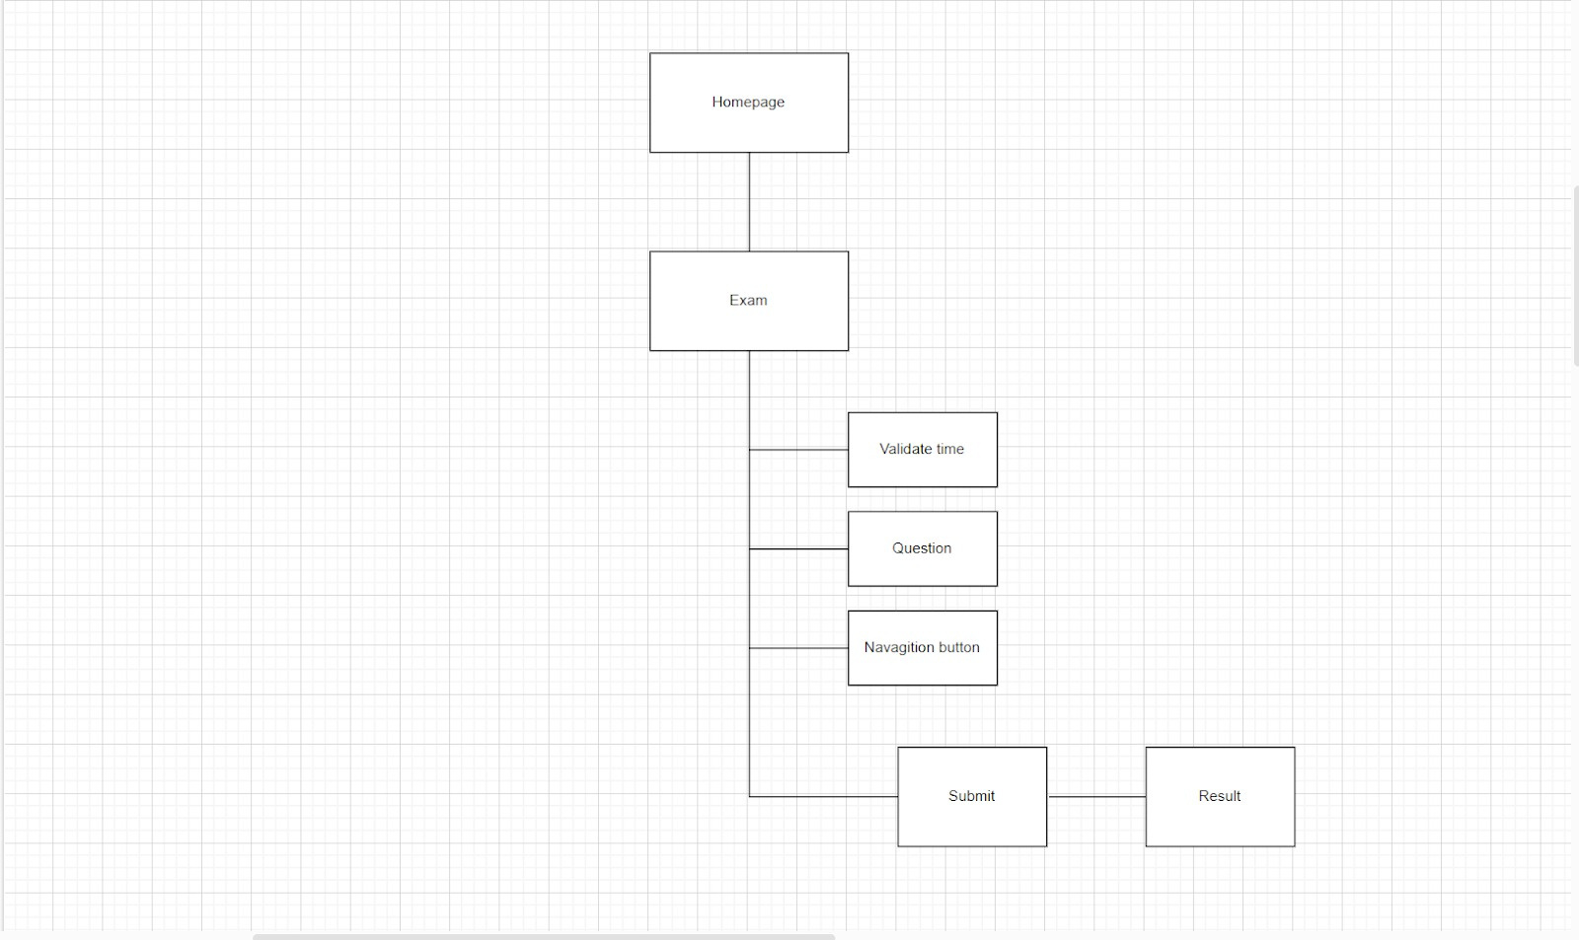
User Sitemap

Slide 8
Part 3
Software used in project

Slide 9



Software
MongoDB server
Apache NetBeans
Studio 3t

Slide 10
Part 4
System Design

Slide 11
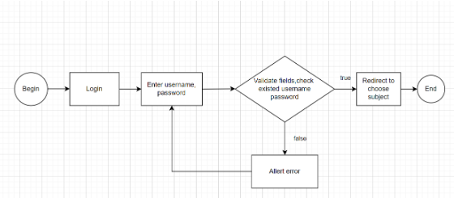
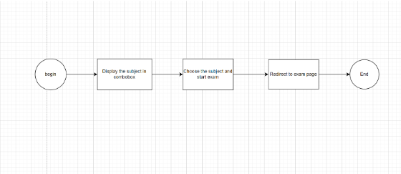
Process Diagram
Login
Choose subject

Slide 12
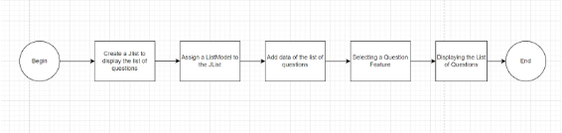
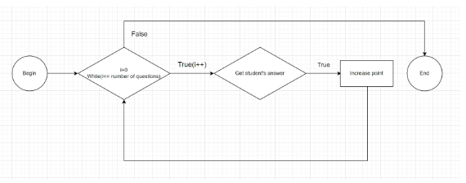
Process Diagram
List question
Calculate point

Slide 13
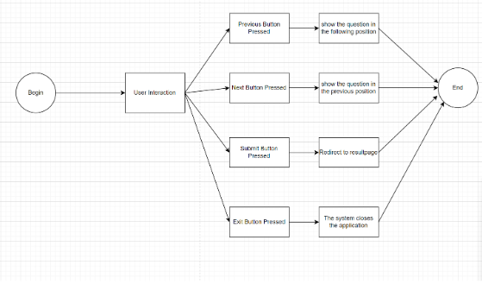
Process Diagram
Navigation button

Slide 14
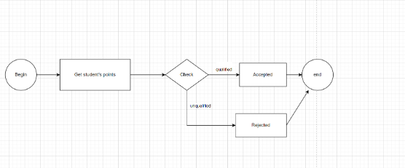
Process Diagram
Result

Slide 15
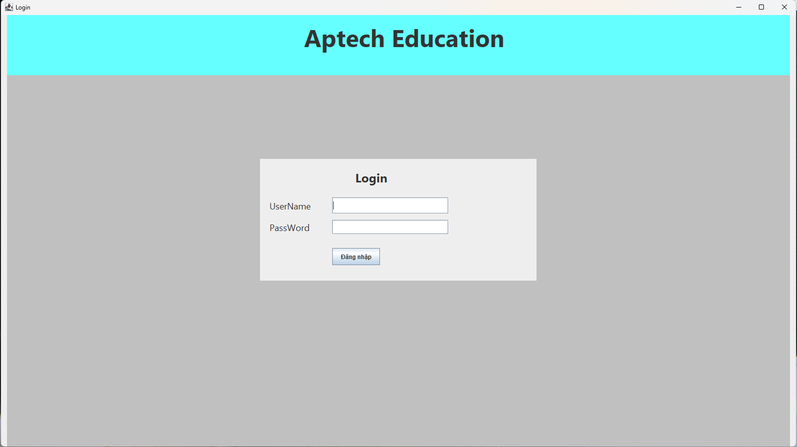
Login

Slide 16
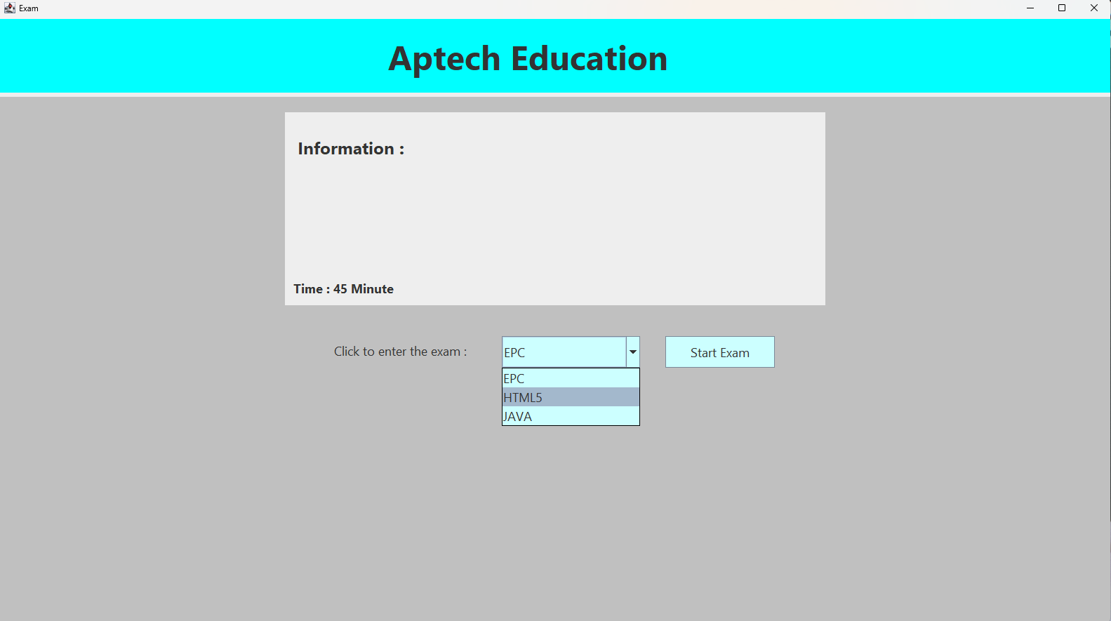
Homepage

Slide 17
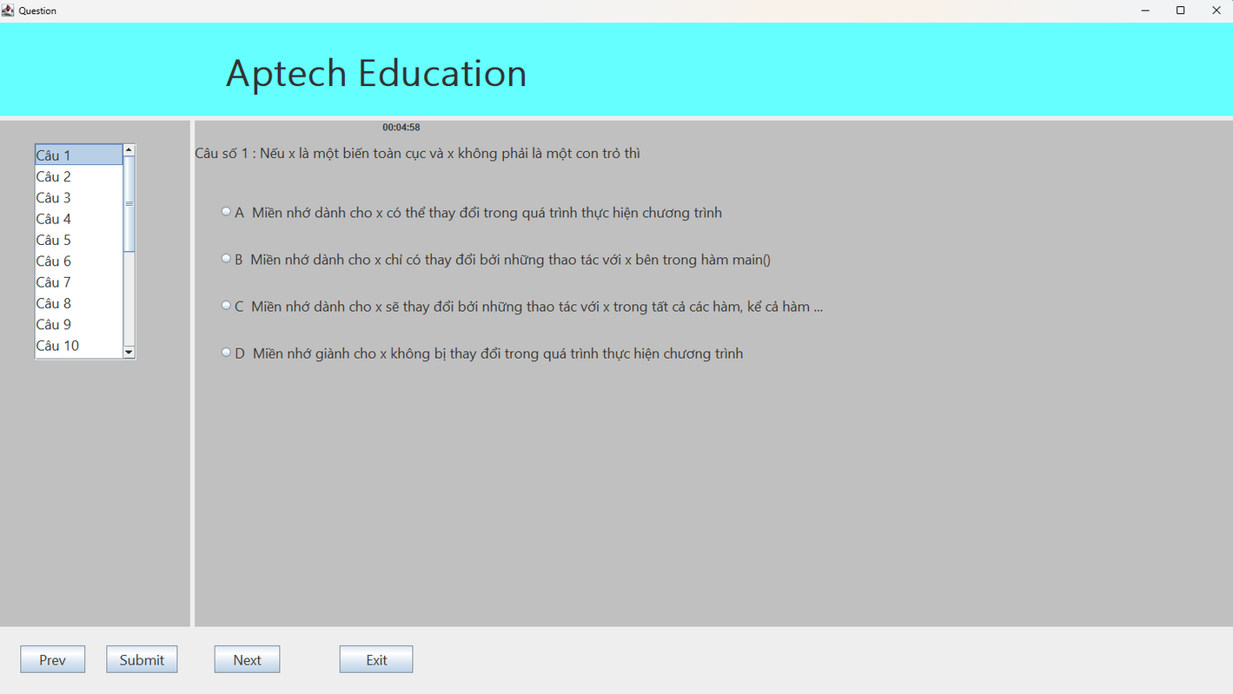
Exam

Slide 18
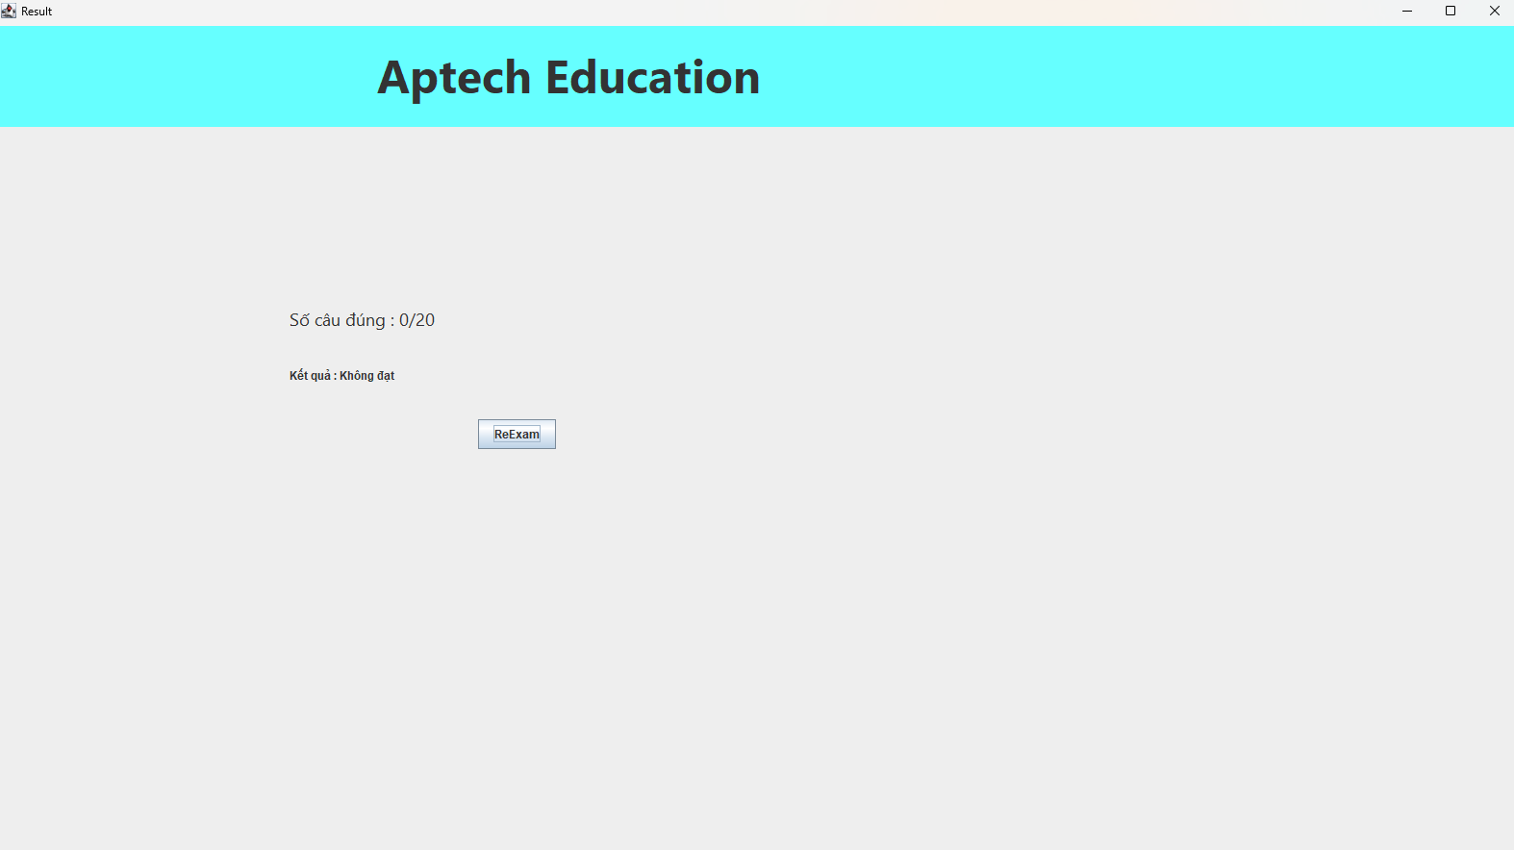
Result

Slide 19

Thanks for watching

